Slide 1

MIZUGUNA -01 A small overview by Vibhanshu Jain

Slide 2
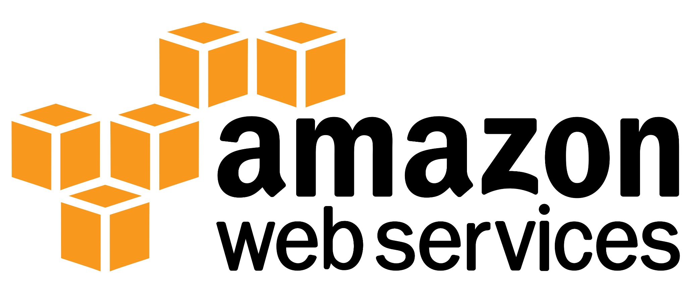

Slide 3
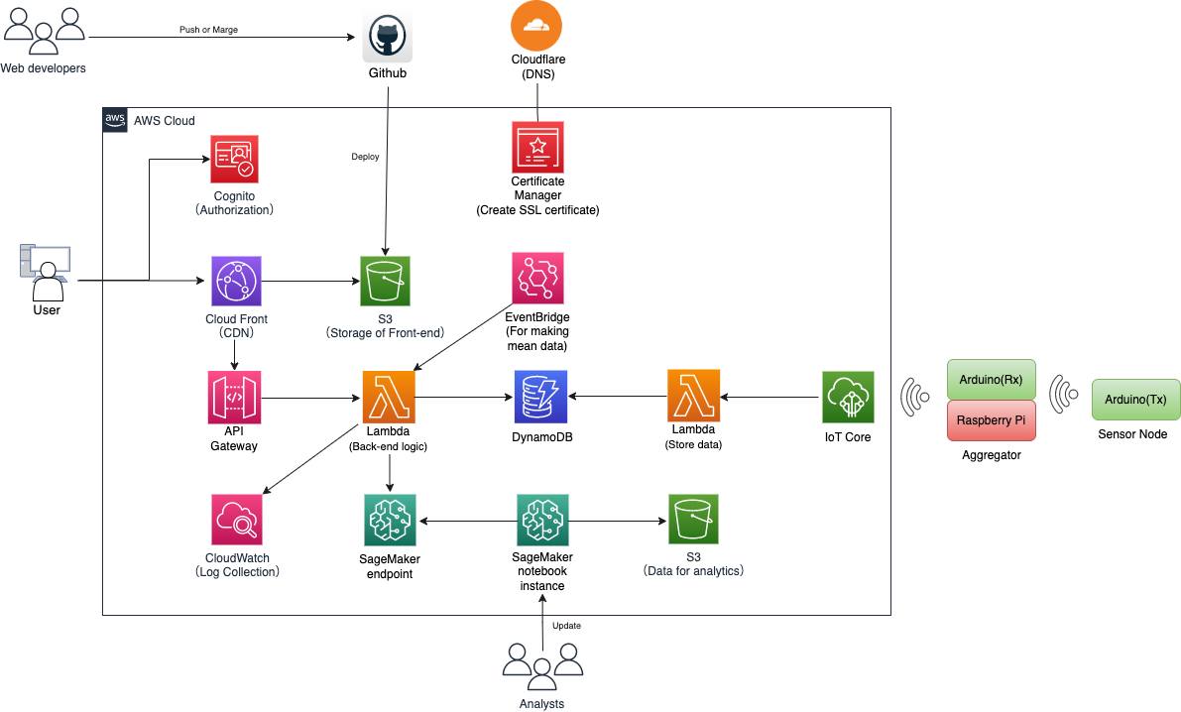
^{Architecture Overview}

Slide 4
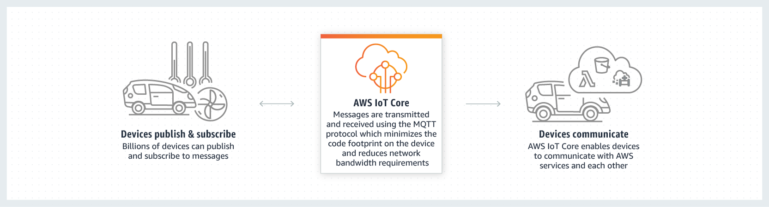
^{AWS IoT Core}
https://aws.amazon.com/iot-core/

Slide 5

^{AWS Lambda}
Run code without thinking about servers or clusters
https://aws.amazon.com/lambda/

Slide 6

Amazon DynamoDB
Fast, flexible NoSQL database service for single-digit millisecond performance at any scale
https://aws.amazon.com/dynamodb/

Slide 7
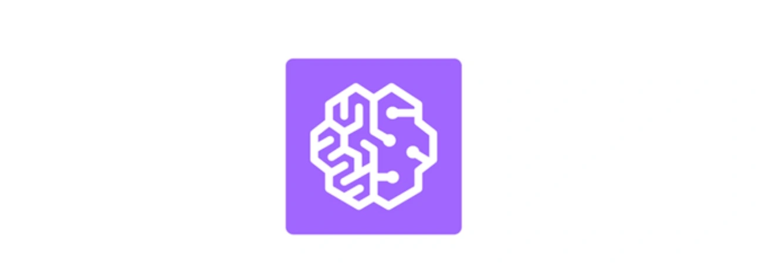
Amazon SageMaker
Build, train, and deploy machine learning (ML) models for any use case with fully managed infrastructure, tools, and workflows
https://aws.amazon.com/sagemaker/

Slide 8

Amazon S3
Object storage built to retrieve any amount of data from anywhere
https://aws.amazon.com/s3/

Slide 9

Amazon Cognito
Implement secure, frictionless customer identity and access management that scales
https://aws.amazon.com/cognito/

Slide 10







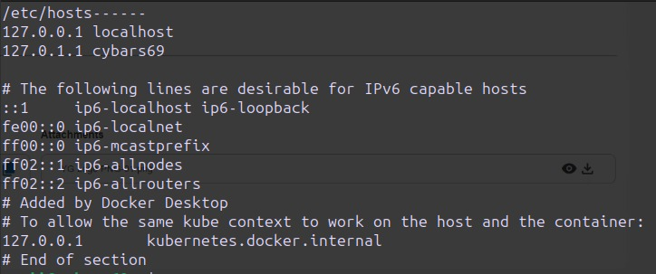
Some more things to explore while developing

Slide 11
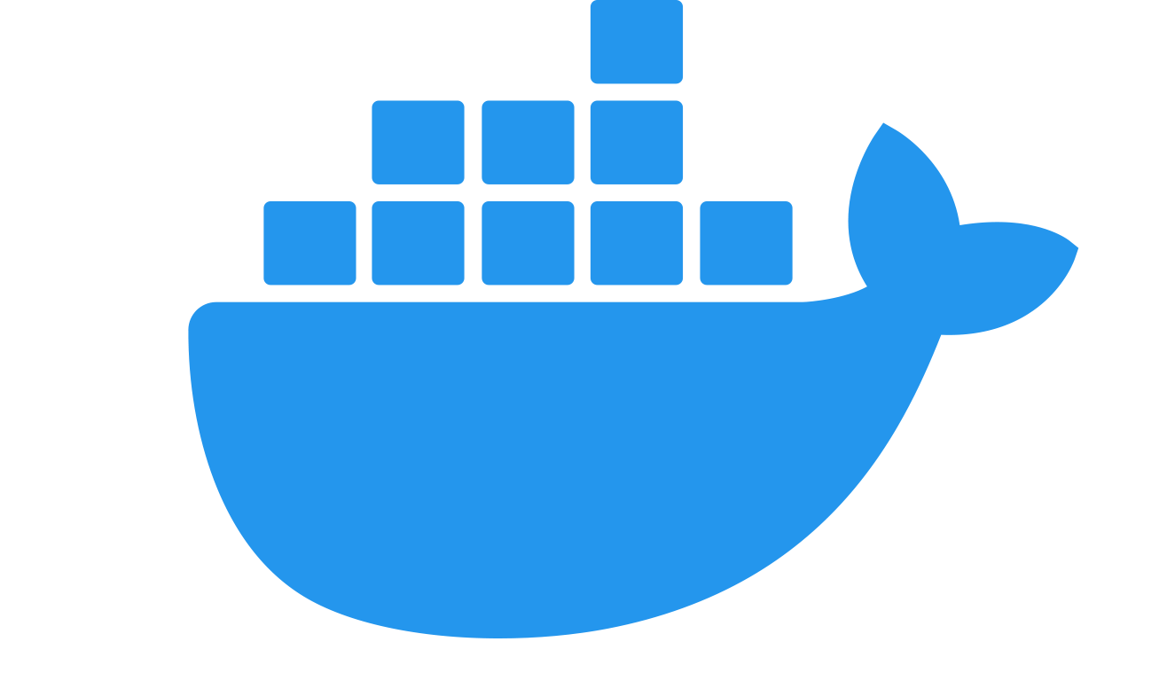
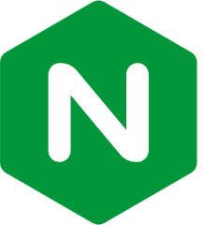


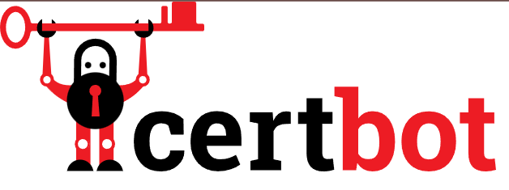



Some more things to explore

Slide 12
Thankyou!

